Slide 1


Project presentations
Data Analysis 2026-I

Slide 2

Today's session
20/05/2026
3
25
10
Data Analysis Projects
Minutes per group to present
Minutes for questions and observations per group
First heads-up: 10 minutes left
Second heads-up: 5 minutes left
1
We'll be raffling off a book at the end of the session. Good luck, everyone!
Data analysis

Slide 3
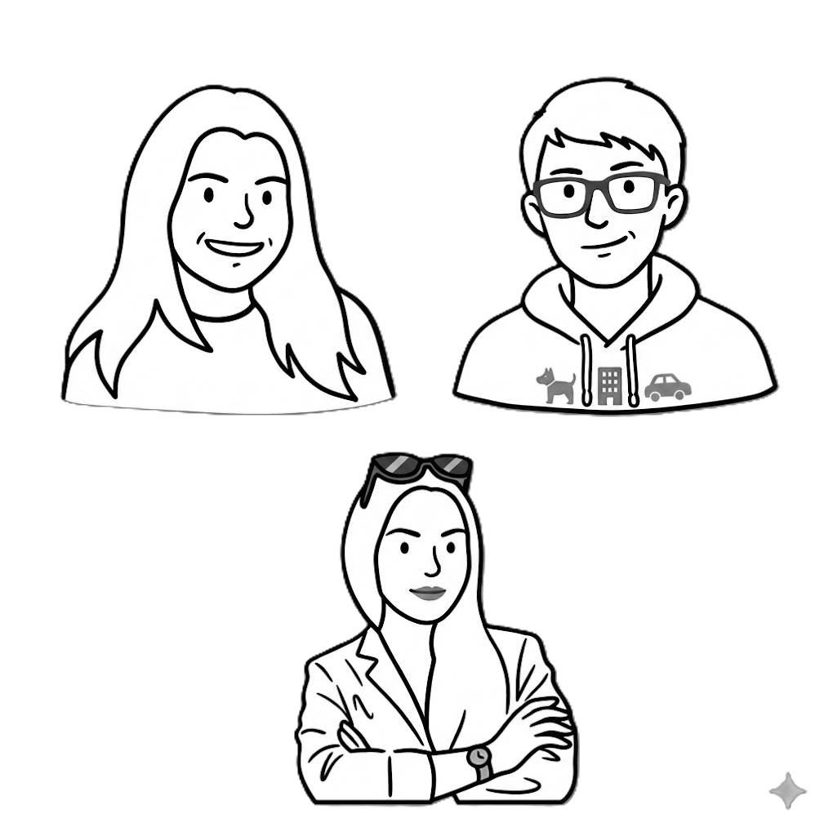
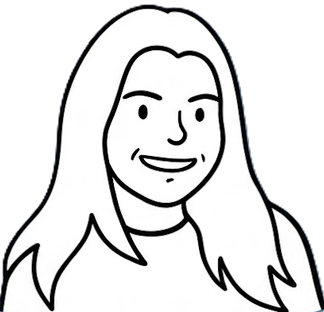
Today's session
20/05/2026
Nicolás Vargas, Catalina Castrillon and Marilyn Aguilar
Why don’t they vote? Electoral abstention in Bogota's Universities for Youth Councils
Why, despite being part of a highly educated population with greater access to information, many students remain disengaged from electoral processes such as the Youth Councils elections?
Sofia Gualdron, Saray González and Sara Lucía Rojas
Occupational Stress In Professors Of Finance, Government And International Relations
To what extent do the type of courses taught (quantitative), research responsibilities, and problem-solving pedagogy mediate the relationship between program affiliation and occupational stress levels in professors
Miguel Ángel Garzón, Nicolas Guerrero and Camila Cubillos
Modelling Childbearing Intentions at U Ext: An Explanatory Sequential Mixed-Methods Approach to Feminist Identity and Miller’s TDIB Model
To what extent does feminist identity explain the motivations and desires underlying the childbearing intentions of undergraduate students at the Faculty of Finance, Government and International Relations (FIGRI)?
Data analysis

Slide 4

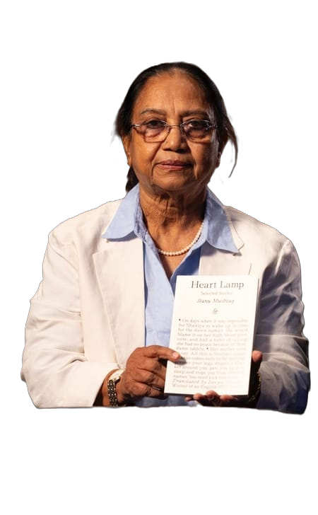
Today's session
20/05/2026
Heart Lamp is the first collection of short stories to win the prize – written over 30 years, the 12 stories chronicle the lives of women in patriarchal communities in southern India
Data analysis

